Slide 1

Welcome to:
Maker Training Session
5:30 PM Tuesday, February 6, 2018
Broun Hall, Room 235

Slide 2

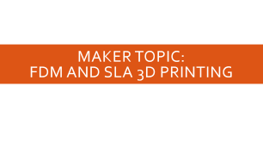

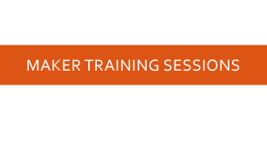

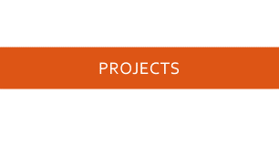
Agenda

Slide 3
About SPARC

Slide 4
Introduction
Student lead organization at Auburn University.
Creates and fosters an environment of creativity and innovation through collaborative projects.
A place to test out ideas, integrate concepts learned in class, and learn skills that will be instrumental when working in the workforce.
No prior experience is required, only a willingness to learn.
Great for students of all ages and majors.

Slide 5


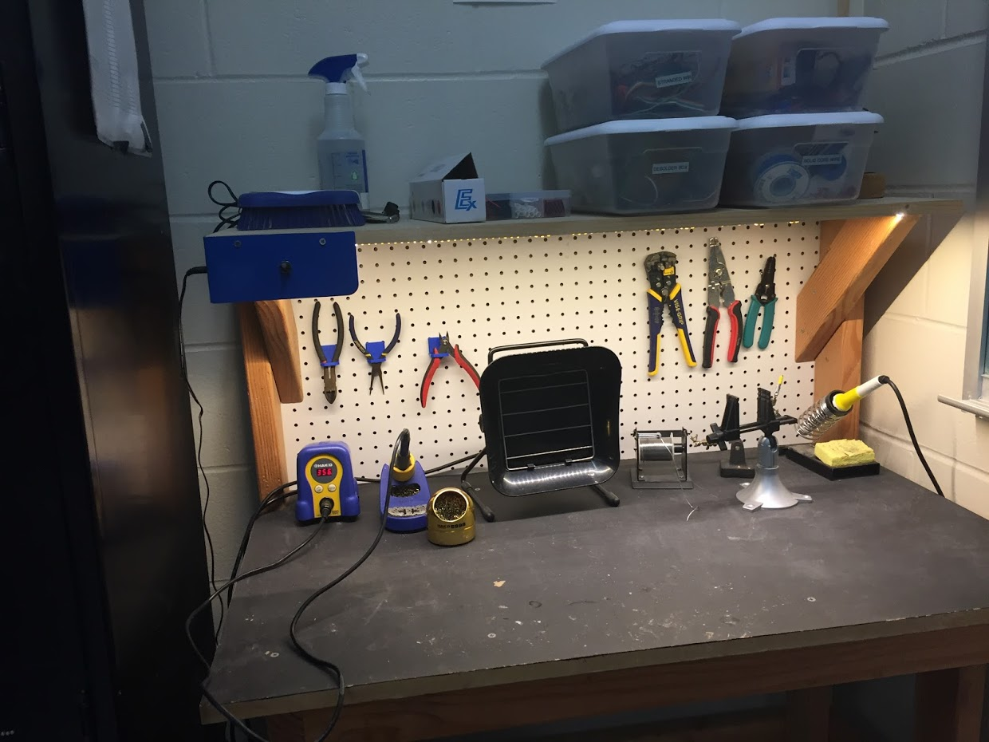
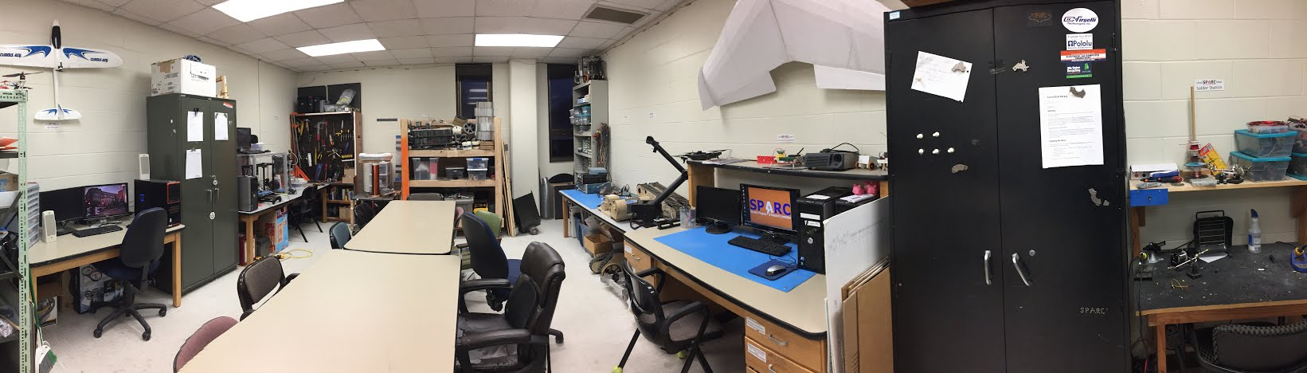
Our Lab
Broun Hall
Room 367

Slide 6
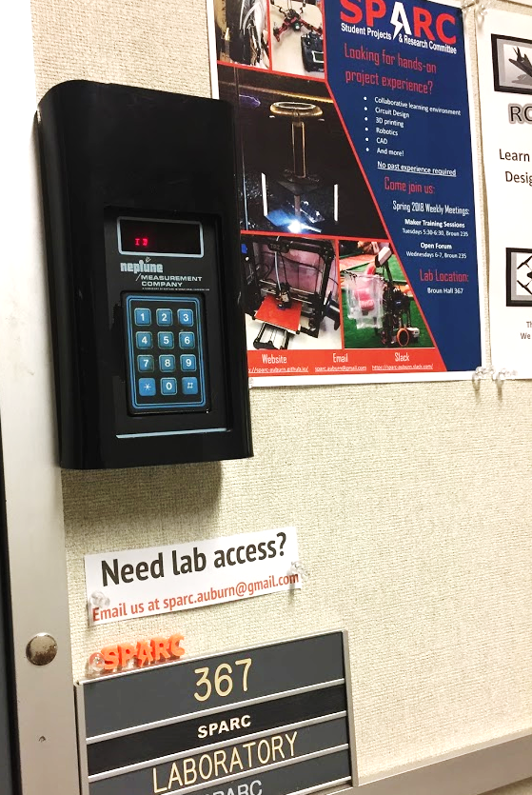
How to become a Member
Log 5 constructive hours in the lab
Write the times on the sheet on the clipboard next to the door.
Contact us at sparc.auburn@gmail.com
We will respond with the instructions to get an access code.

Slide 7
SPARC Meetings
Open Forum
Discuss status of active projects
Learn about and discuss specific topic in the realms of technology, engineering or making.
Wednesdays at 6:00 PM
Maker Training Session
Learn about a specific skills like 3D printing, CAD, electrical prototyping, and robotics.
Centered around SPARC Sumo Bot Competition
Tuesdays at 5:30 PM
Project Meetings
Project members come together to talk about detailed progress.
Meeting times and locations vary from project to project.

Slide 8



Partner Organizations
NASA Robotics Mining Competition Team
President: Jeremy Frasher <jjf0010@auburn.edu>
Meets on Mondays 6-7, SPARC Lab, Broun 367
RC Hobbyist Club
President: Craig Legrand <cbl0019@auburn.edu>
Meets on Mondays 3:30-4:30, SPARC Lab
Fridays 3:30-5:00, Broun 235
IEEE Auburn University Student Branch
President: Michelle Kniffen <mek0027@auburn.edu>
Meets on announced Mondays, Broun 238

Slide 9




More Information about SPARC
Website
http://sparc-auburn.github.io/
Github
https://github.com/SPARC-Auburn
Slack
https://sparc-auburn.slack.com/
Email
sparc.auburn@gmail.com

Slide 10
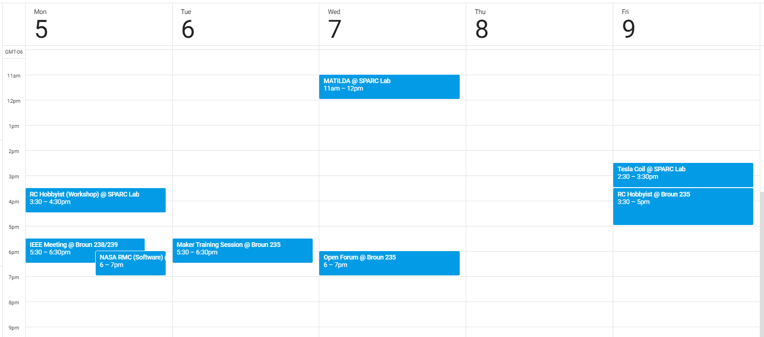
Meetings this Week

Slide 11
Outreach

Slide 12
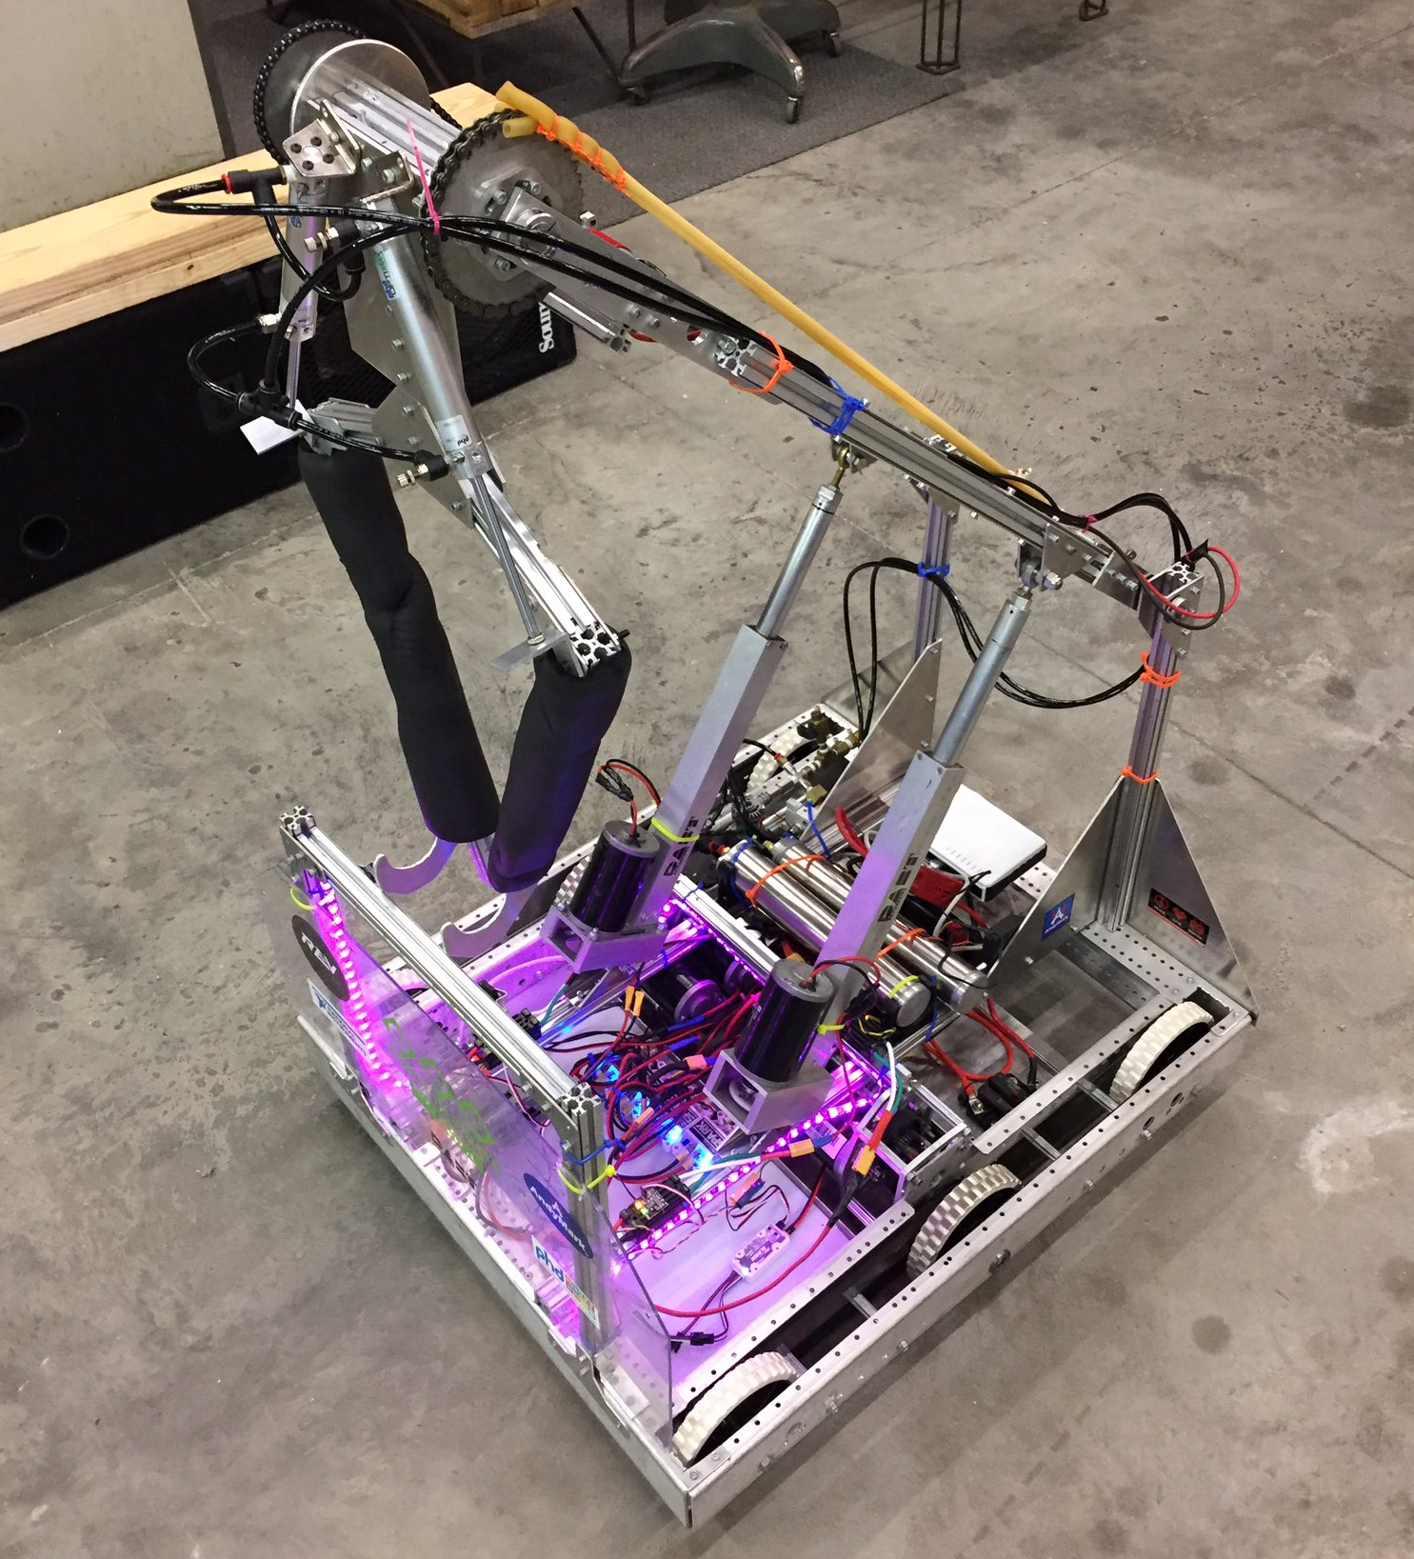
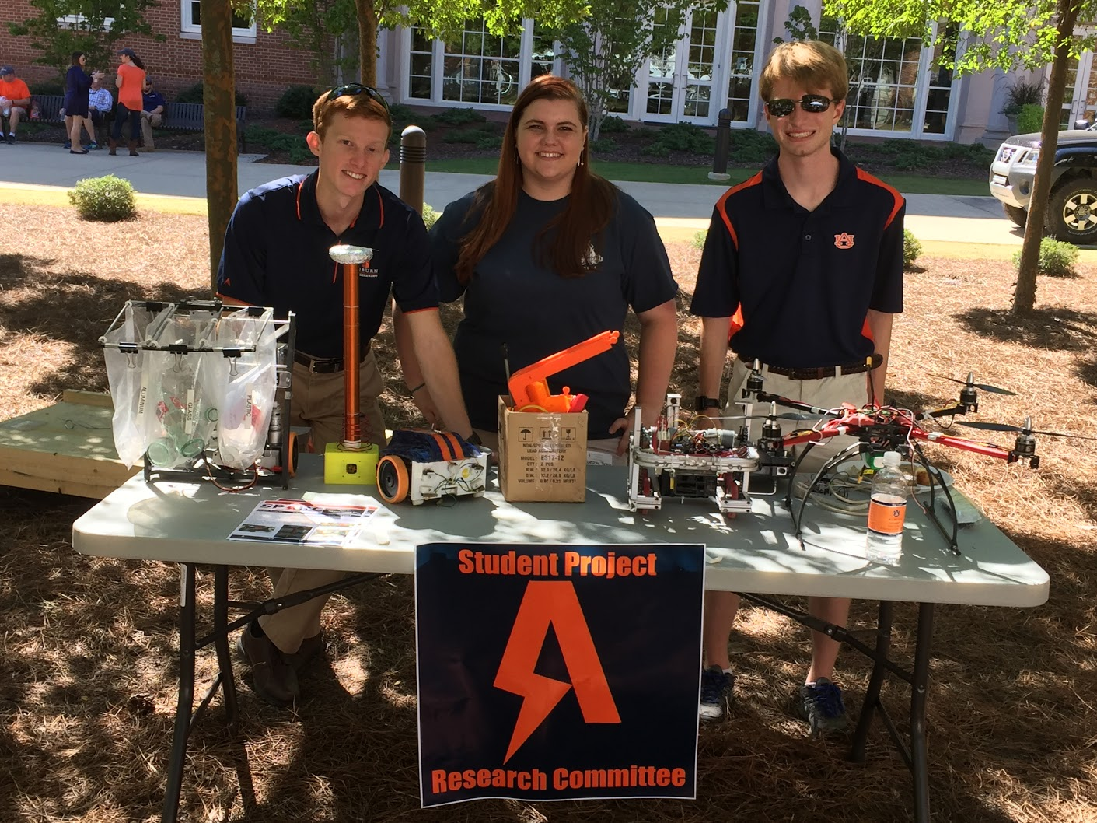
Outreach Events
VEX Robotics Competition
February 10, 2018 9am- 3pm
Free Food and T-Shirt
Opelika HS FRC Team
Help mentor a FIRST Robotics Competition (FRC) Team
Mon Tue Thu: 3:30-6:30, Fri: 3:30-9:30, Sat:10-6
E-Day
Help display projects in Broun, Student Center, and Concourse to high school students.
Friday, February 23rd
Robot in 3 Days 2018 Bot
Engineering Tailgate 2016 SPARC Table
Notes:
Fall 2016
Loachapoka Robotics Mentoring- Mondays, Tuesdays, and Thursdays 3:00PM to 4:30PM
ECE Minority Presentation- November 14th
AJHS E-Day- November 17th
South’s Best- December 3-4th
SCORE Claw Machine- December 3-4th
Spring 2016
E-Day- Late February or early March
SPACE Day- Possible Event Next Semester
IEEE Sumo Robotics Competition (with local middle and high schools)- Spring 2017

Slide 13
Projects

Slide 14
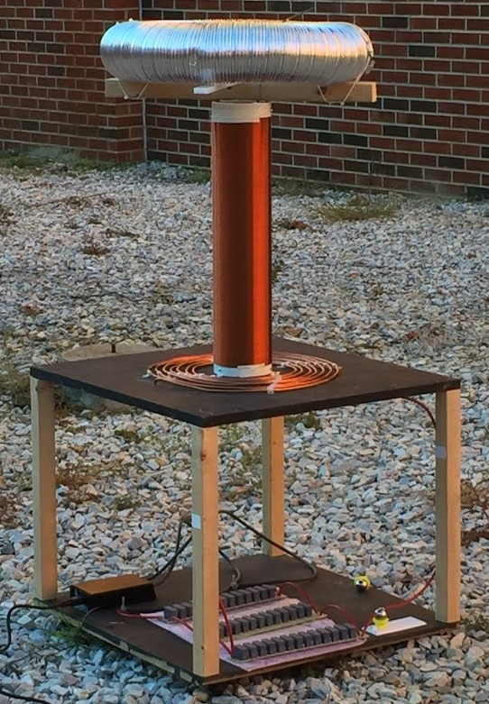
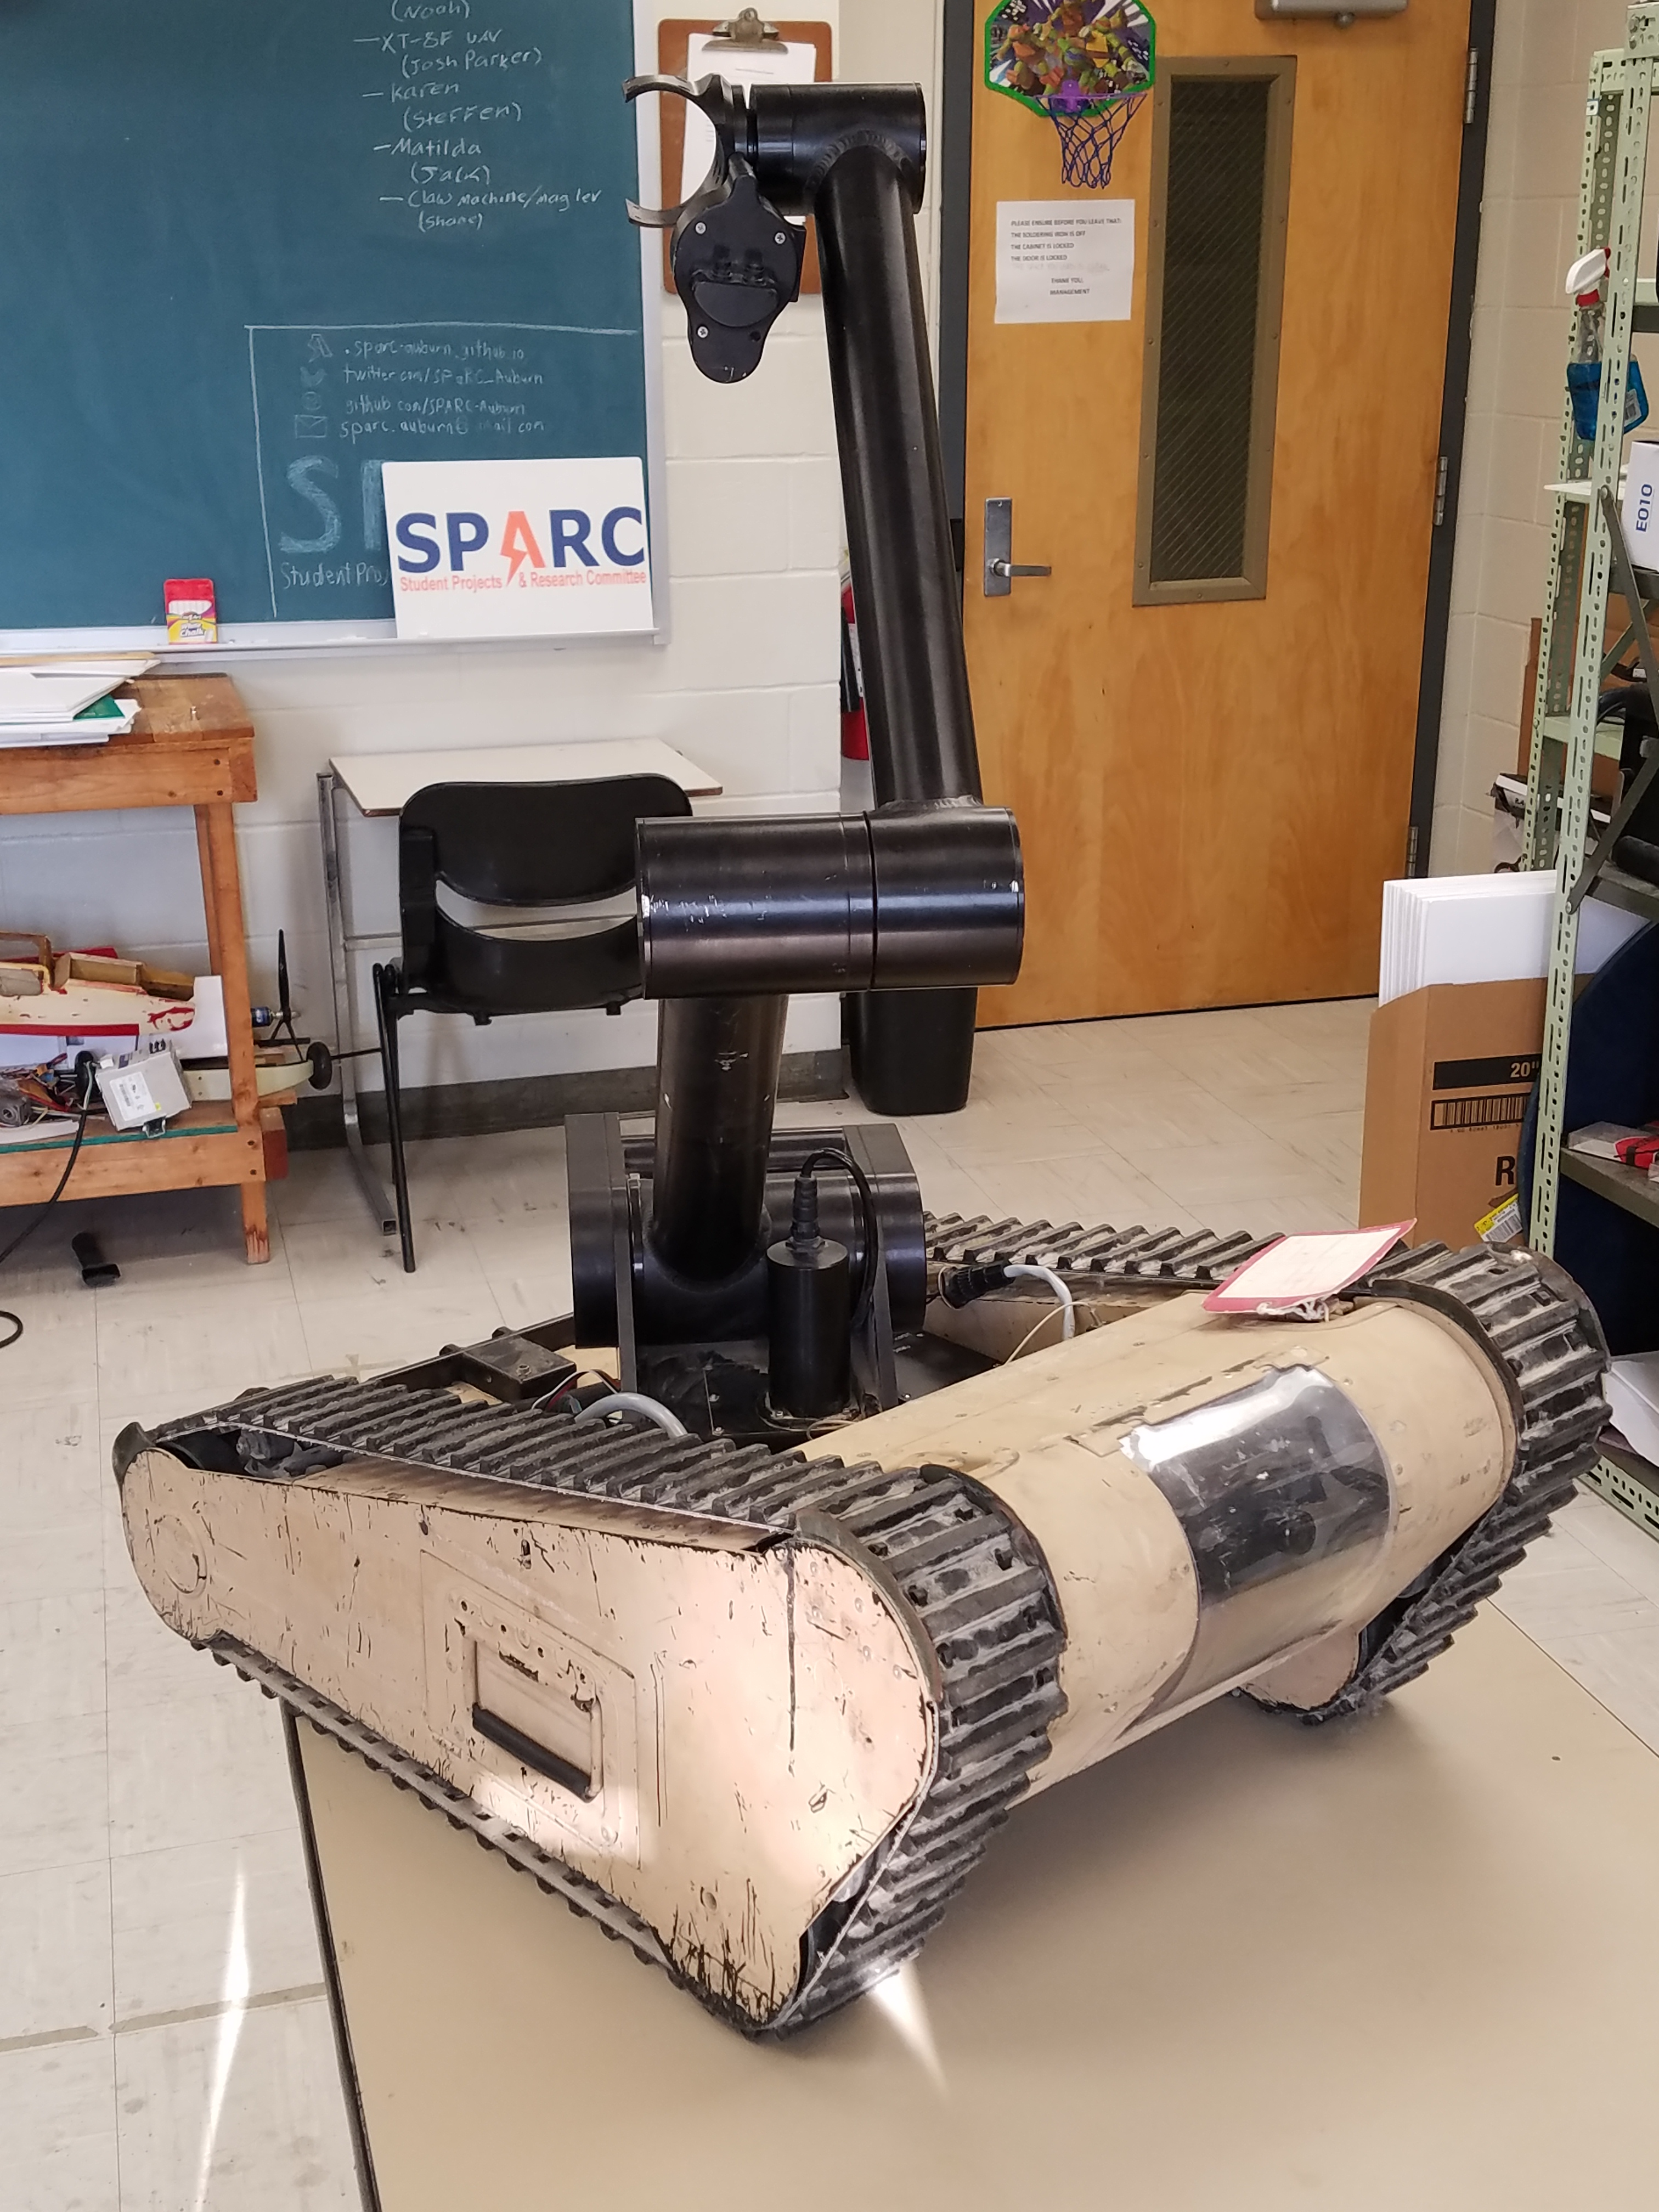
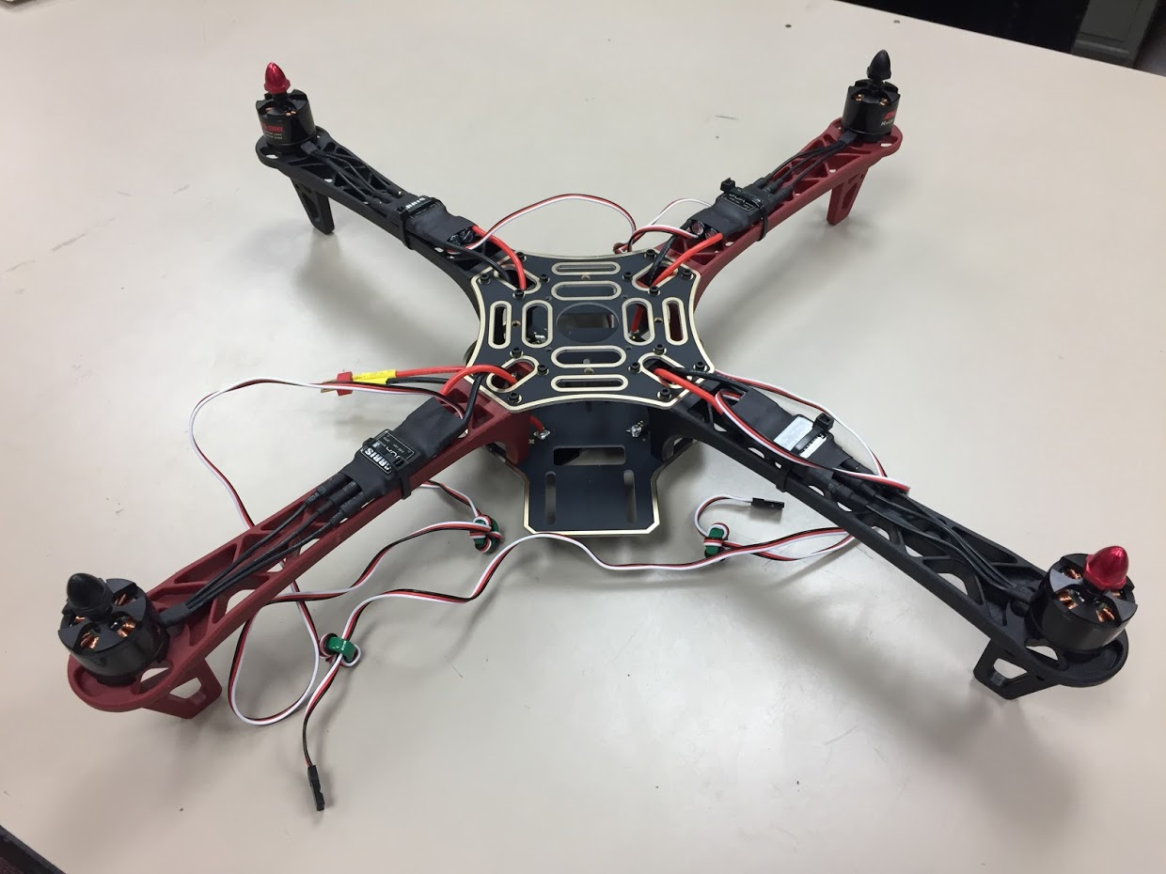
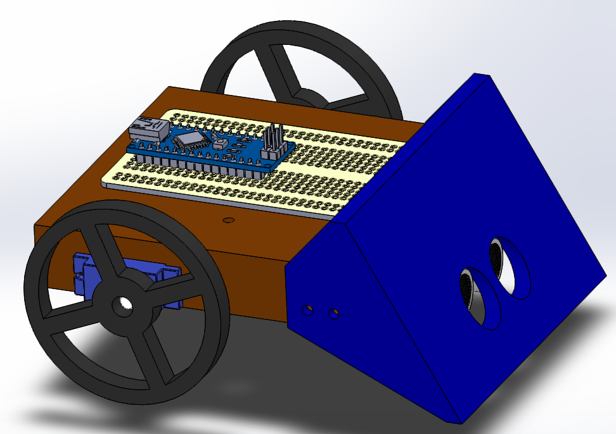
Spring 2018 Main Projects
MATILDA Robotics Platform
Tesla Coil
Unmanned Aerial Systems
Sumo Bot Competition

Slide 15
Sumo Robotics Tournament

Slide 16
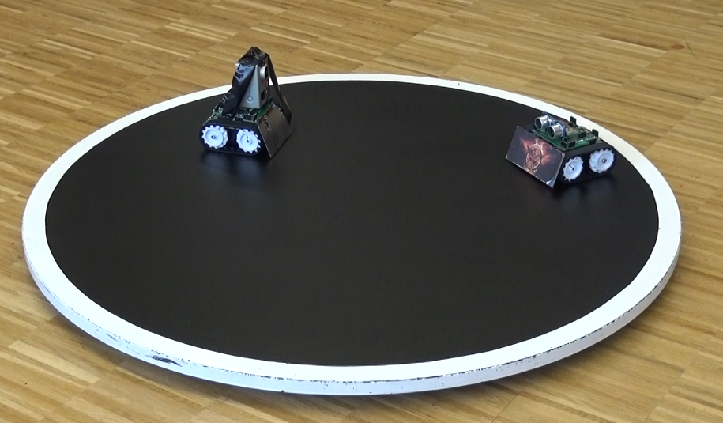

What is a Sumo Bot Competition?
Two robots are placed in a ring
Goal: attempt to push each other outside of ring.
Typically autonomous
First robot that touches outside of the ring loses the round.
The competitions “are non-destructive, family friendly, and great learning experiences.”
Classes of Sumo Bots
Japanese class (< 6.6 pounds)
Mini-class (< 1.1 pounds)
More information: http://www.robotroom.com/SumoRules.html
https://mcuoneclipse.com/2014/12/21/sumo-with-gopro-and-other-sumo-videos/
Mini Class
Japanese Class

Slide 17
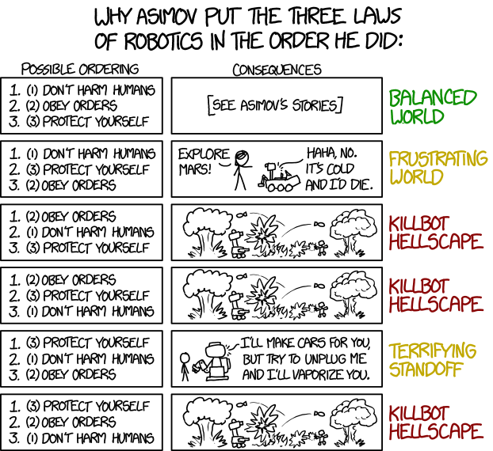

SPARC Sumo-Bot Requirements
Weight Constraint: < 750g(1.65lbs)
Size Constraints (at start of round)
Width: 15cm (5.91”)
Length: 15cm (5.91”)
Height: $∞$
Robots must not
Emit smoke or fire
Leak, stain, or soil
Disperse powder, grit, or grime
Spray, throw, or use projectiles
Jam, shock, or electromagnetically interfere
Snare, entangle, or employ nets/rope
Scratch, gouge, or scrape
Have sticky/magnetic/suction wheels
XKCD: https://xkcd.com/1613/

Slide 18
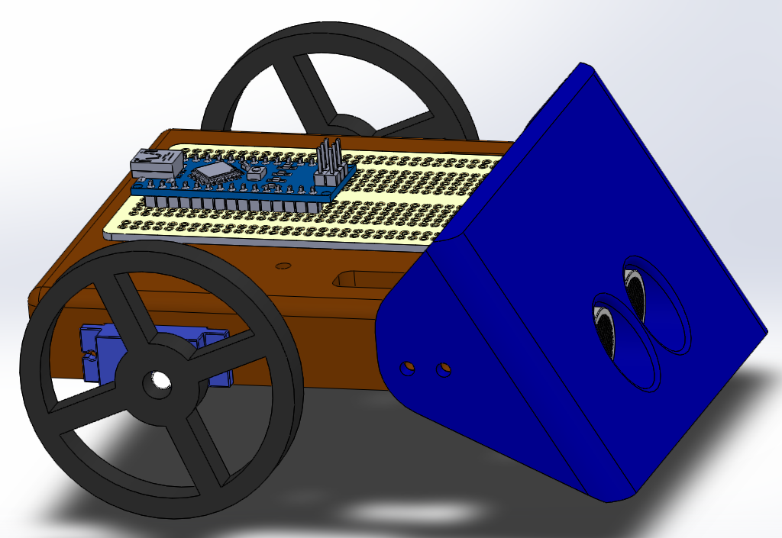
SPARC Competition Part Constraints
up to 3 micro continuous servos
up to 2 servo wheels
all mechanical frame must be 3D printed
no sheet metal or raw plastics allowed
use any screws, nuts, washers
use Arduino Nano (clones), protoboard, wires, etc.
up to 2 Ultrasonic sensors
up to 4 line following sensors

Slide 19
Maker Training Sessions

Slide 20
Maker Training Session Topics
Version Control (Git and GitHub)
3D CAD Parts (Solidworks)
3D Printing (Lulzbot Taz 3 w/ Cura Lulzbot Edition)
3D CAD Review and Assemblies (Solidworks)
Electrical Prototyping and intro to Arduino
Soldering and Electrical Fabrication
Basic Robotics Programming and PWM
Basic Sensor Programming

Slide 21
Maker Topic: FDM and SLA 3D Printing

Slide 22
Types of 3D Printers
Filament Based
Fused Deposition Modeling (FDM)- like a glue gun
Resin Based
Stereolithography (SLA)- UV single point laser cured liquid resin
Digital Light Processing (DLP)- light projector cured liquid resin
Powder Based
Selective Laser Sintering (SLS)- laser sintered powder
Selective Laser Melting (SLM)- laser melted powder
Electron Beam Melting (EBM)- electron beam melted powder
Binder Jetting (BJ)- drop-on-powder and binding agent
https://all3dp.com/1/types-of-3d-printers-3d-printing-technology/

Slide 23
FDM vs. SLA 3D Printing
Category | FDM (Lulzbot Taz, etc.) | SLA (Form 2, etc.)
Printer Speed | Faster than average | Slower than average
Minimum Layer Thickness | 50 microns | 25 microns
Typical Printer Price | $200-$3000 | $2000-$20,000+
Material Cost (Per Kg) | $20-$40 | $150-$200
Post Processing | Remove supports | Remove supports/clean in I.P.A.

Slide 24
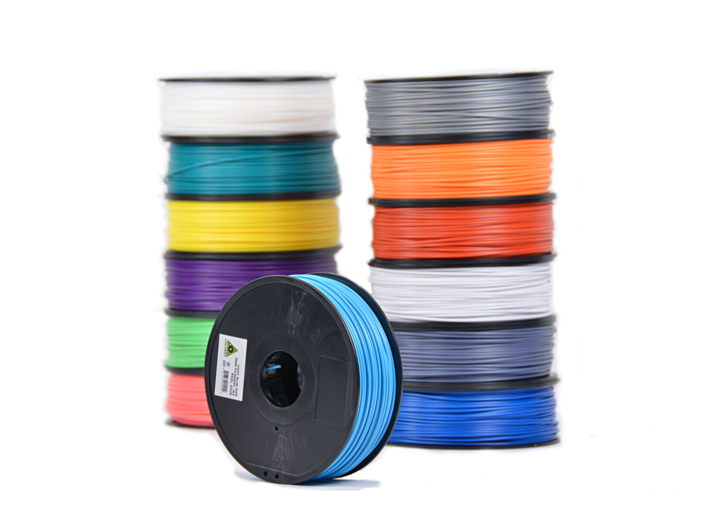
How does FDM 3D Printing Work?
Use a process to form objects in successive layers vertically.
Use a “hot end” that works similar to a glue gun by melting a plastic filament to print each layer.
Many have heated beds to allow better heat distribution preventing the warping of printed objects.
Many use a honeycomb like internal structure to save material and time.
Examples of most popular 3D printing filaments:
ABS
PLA/PLA+
HIPS
Nylon

Slide 25
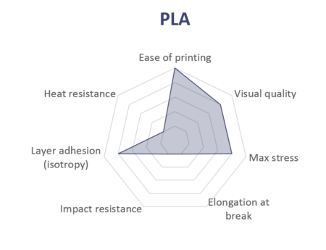
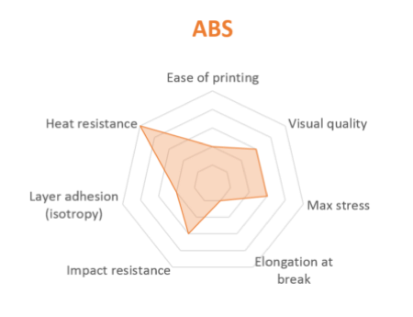
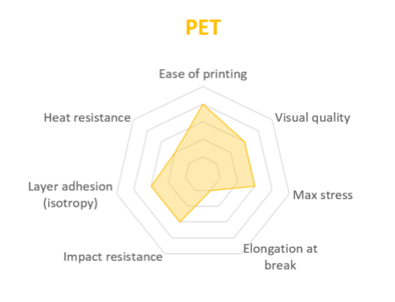
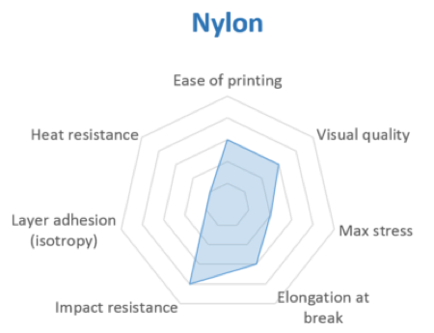
Comparing Popular Filaments
https://www.3dhubs.com/knowledge-base/fdm-3d-printing-materials-compared

Slide 26
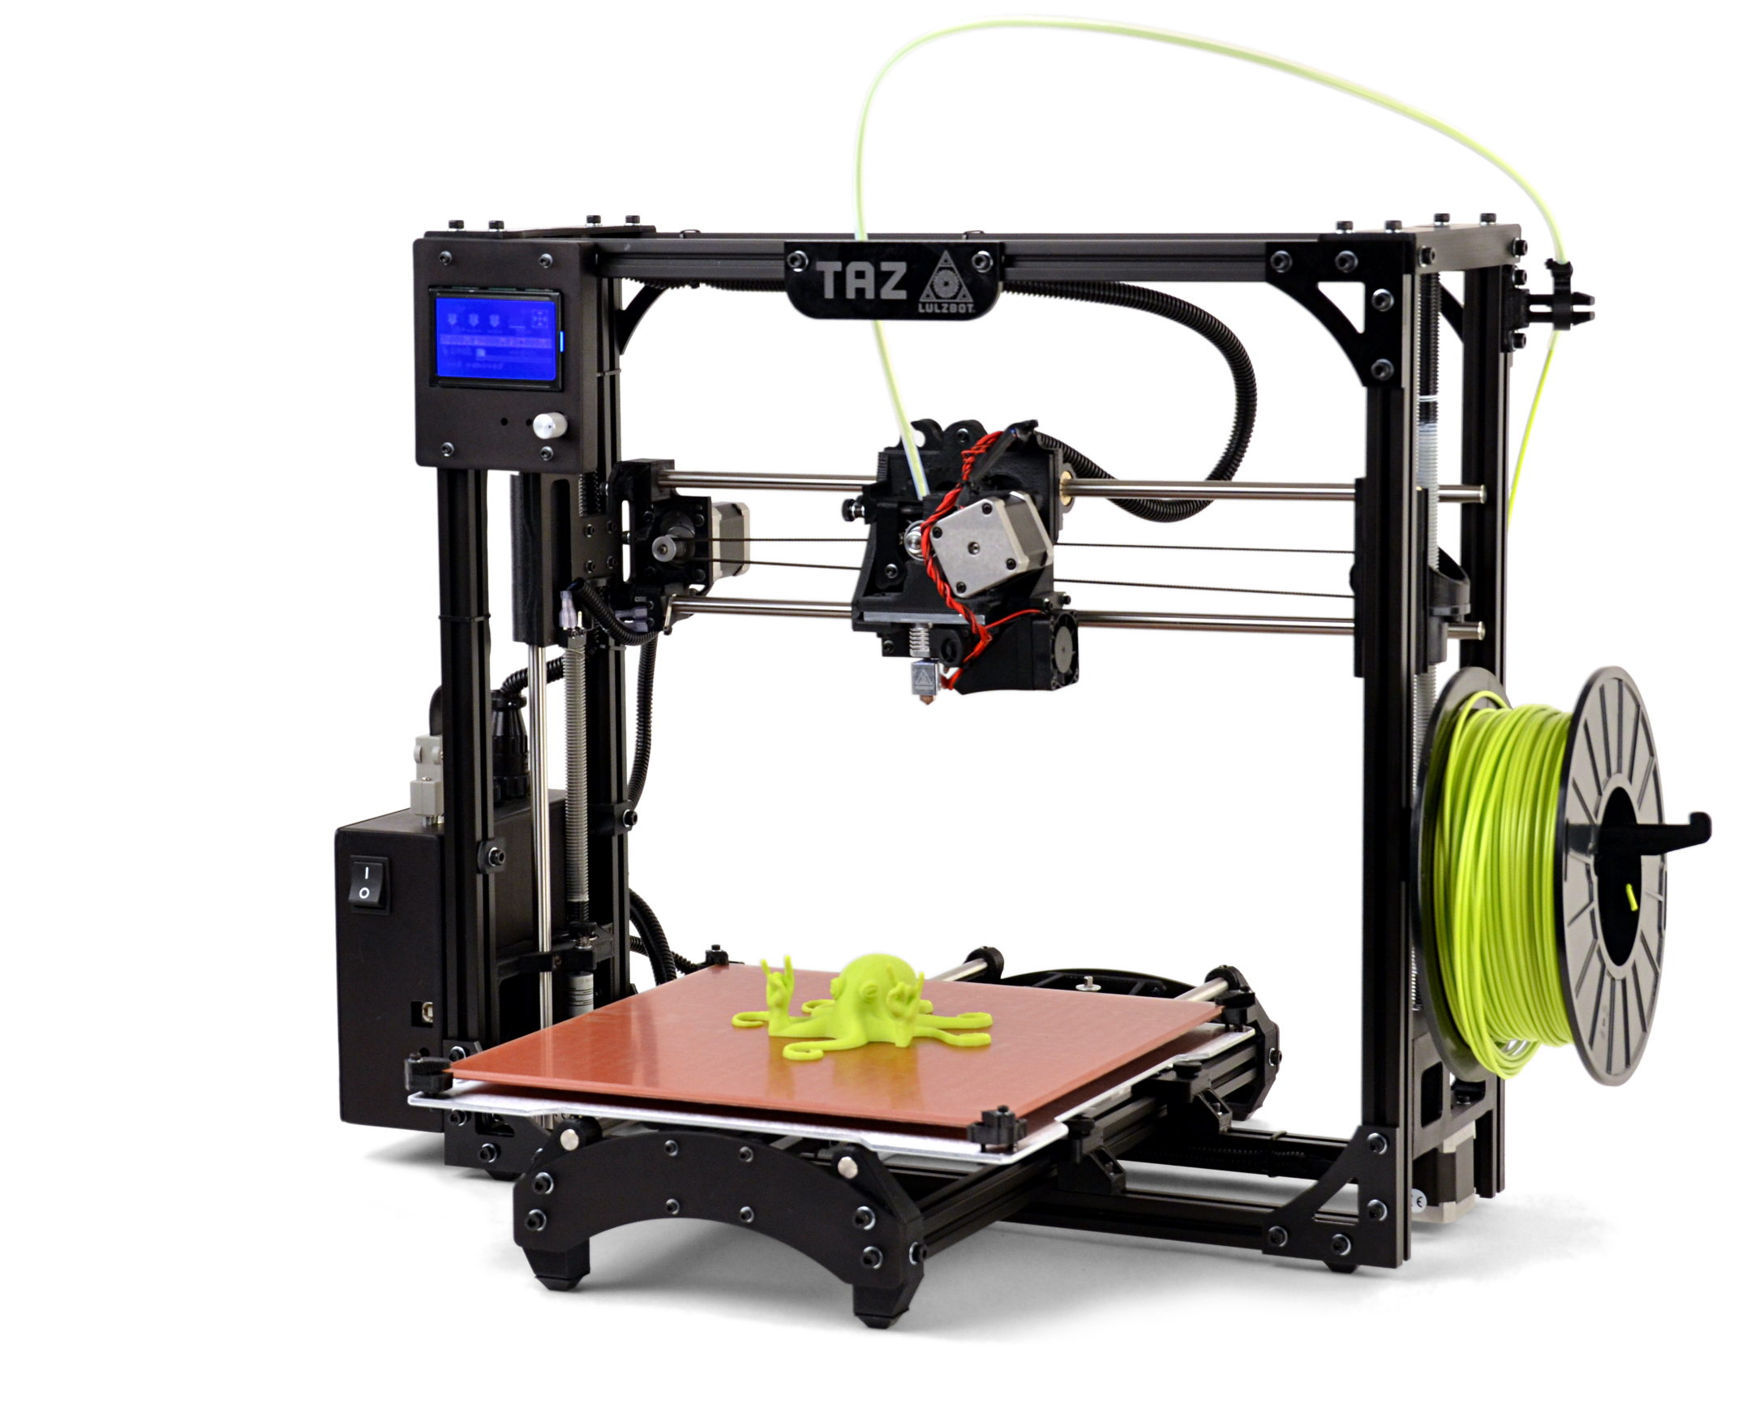
Lulzbot Taz
Control Interface
Filament
Tool Head
Hot End
Control Box / Power Supply
Heated Bed

Slide 27
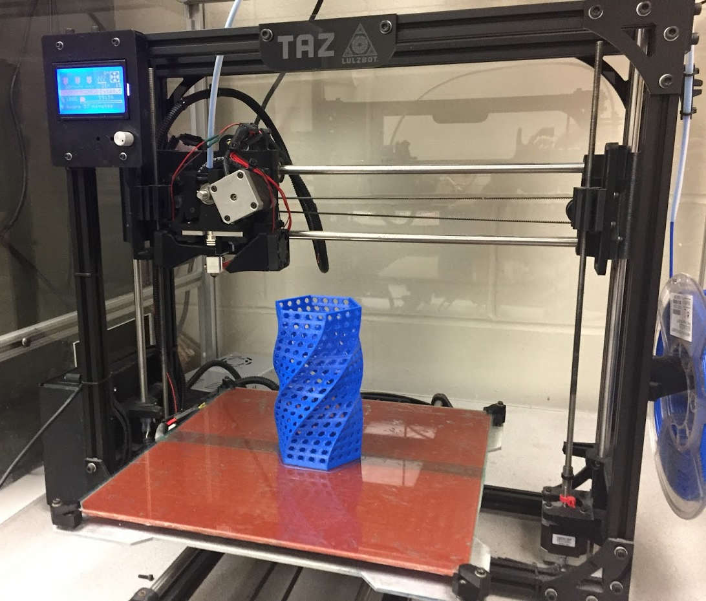
Our Lulzbot
Lulzbot Taz 3
Hot end replaced w/ Hexogonal
Upgraded firmware
Side mounted heatsink fan
Side mounted bed fan
Heated bed w/ PET film
soon to be upgraded to PEI

Slide 28

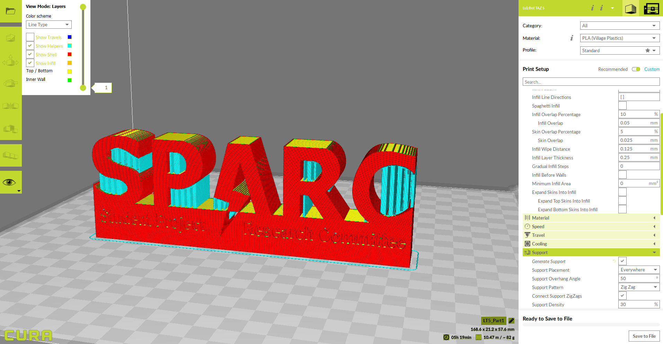
Using Cura Lulzbot Edition
Design 3D model using CAD like SolidWorks, SketchUp, Autodesk, etc.
Save model as .STL file
Open in Cura Lulzbot Edition
Set printer settings such as temperatures and fill density
Generates Gcode File that printer can interpret
Press print or save to SD card

Slide 29
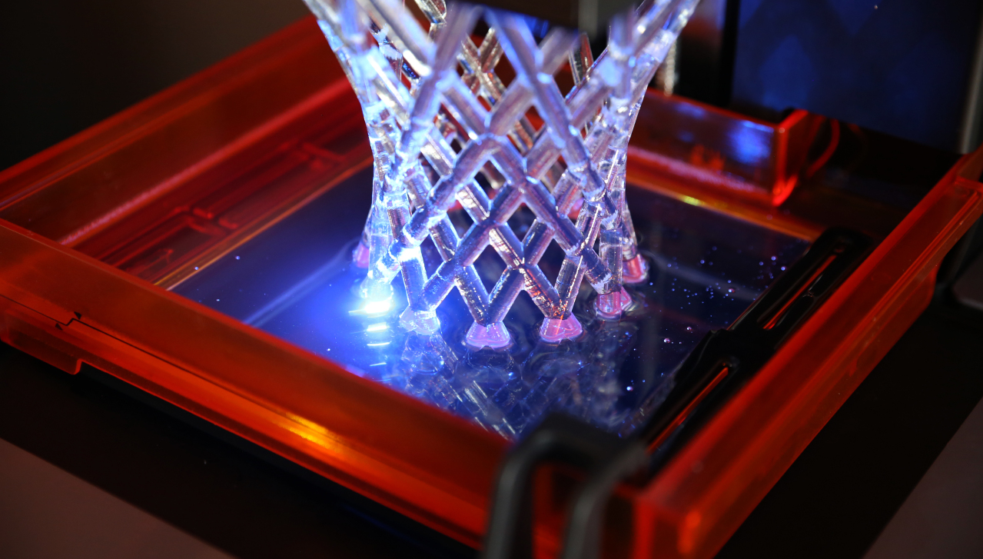
How dOes SLA 3D Printing Work
UV light cures a liquid resin in a tank and cures onto a heated build platform.
Parts are built layer by layer but usually in an inverted orientation.
Isopropyl Alcohol bath is required to wash extra resin off of parts.
Flesh wire clippers are used to remove support structures.
Form 2 Marketing Video: https://www.youtube.com/watch?v=8tn5zA5bNSE&ab_channel=Formlabs
https://techcrunch.com/formlabs-form-2-laser-curing-open/

Slide 30
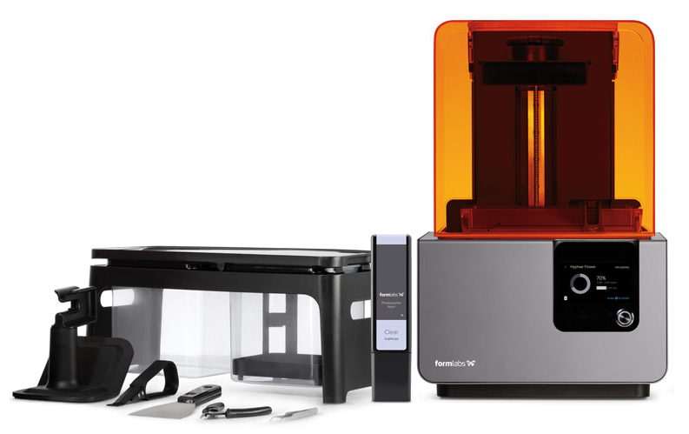
Formlabs Form 2
Build Platform
UV Shield
Isopropyl Alcohol Wash Station
Resin Cartridge
Resin Tank
Control Screen
Post Processing Tools

Slide 31
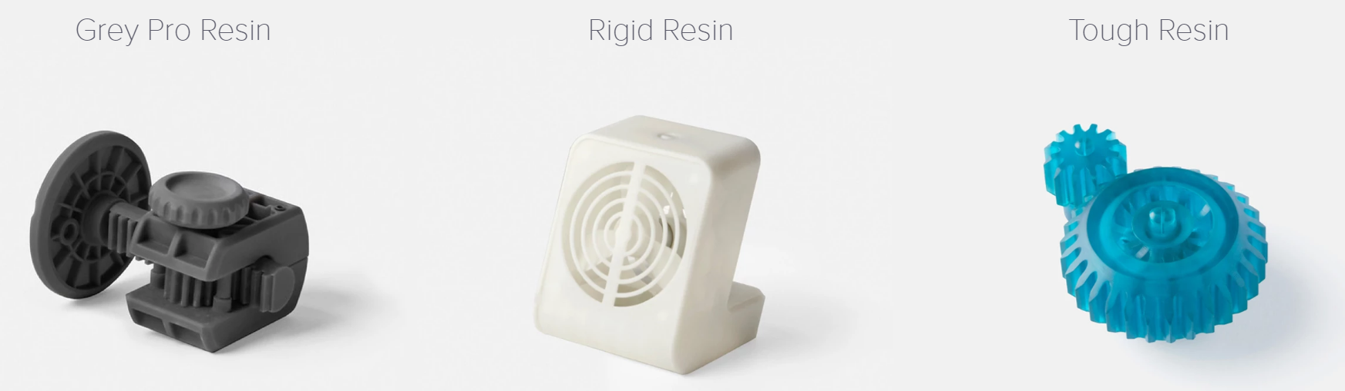
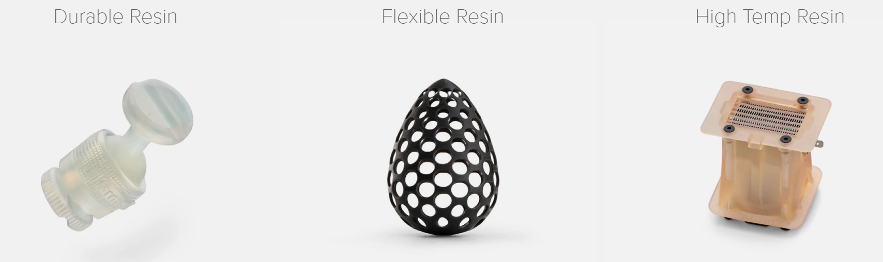
Types of Form Lab Engineering Resins

Slide 32
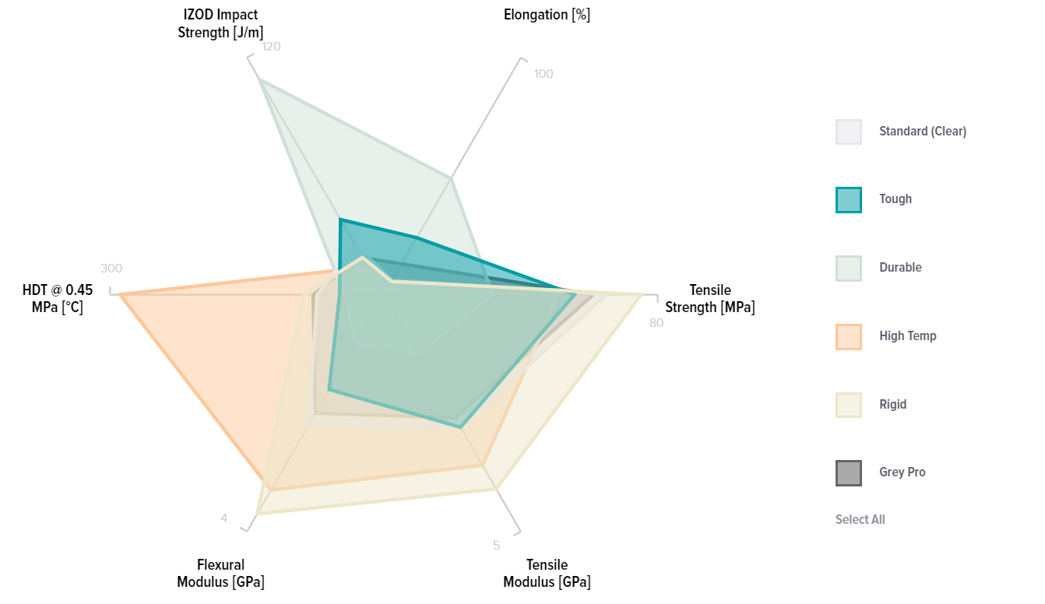
Comparing Form Lab Resins
https://formlabs.com/materials/engineering/#rigid-overview

Slide 33
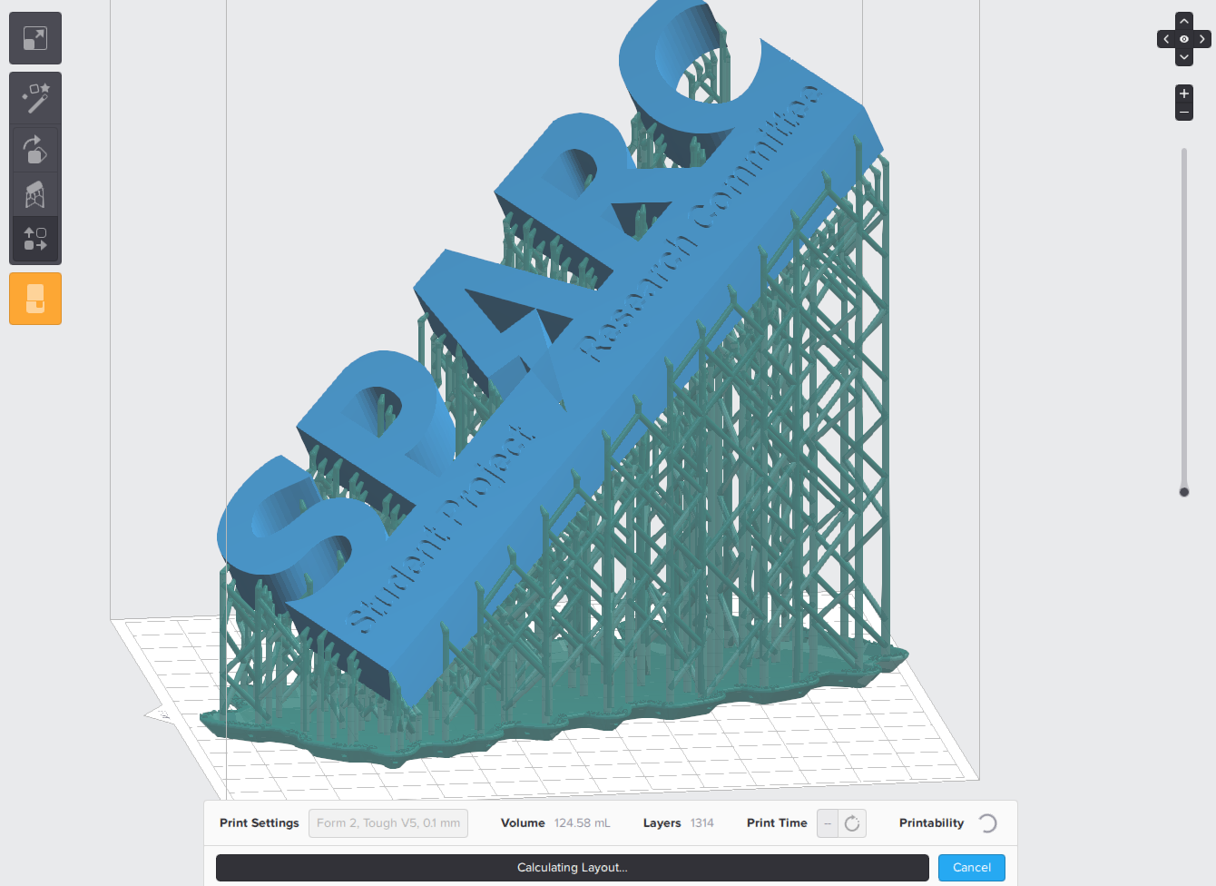
Using Form Labs Pre Form
Design 3D model using CAD like SolidWorks, SketchUp, Autodesk, etc.
Save model as .STL file
Open in Form Labs Preform
Select Resin type and layer height.
Orient model and generate supports.
Use isometric orientation where possible.
Press print to send instructions over to printer via WIFI, ethernet, or USB.

Slide 34



Getting Models for 3D printing
Design your own
SolidWorks, Autodesk Inventor, Fusion 360, Sketch Up, PTC Creo, etc.
Find .STL files online
Thingiverse (https://www.thingiverse.com/)
GrabCad (https://grabcad.com/)
Yeggi (https://www.yeggi.com/)

